Slide 1

Computational Methods in
Power System Analysis
Lecture-10 Solution of Simultaneous Algebraic Equations And Load Flow Studies
By
Dr. Wazir Muhammad Laghari
Electrical Engineering Department
BUET, Khuzdar

Slide 2
Methods to Solve Solution of Simultaneous Algebraic Equations
Direct Method Iterative Method
Elimination Decomposition
Jacobi’s
Method
Gauss-Seidel
Method
Relaxation
Method
Gaussian Elimination Method
Gauss-Jordan Method
Crout’s Reduction Method
Cholesky’s Reduction Method

Slide 3
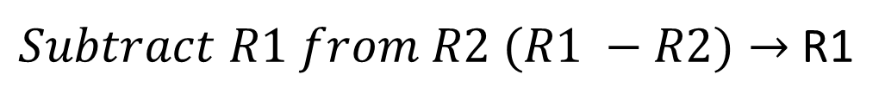
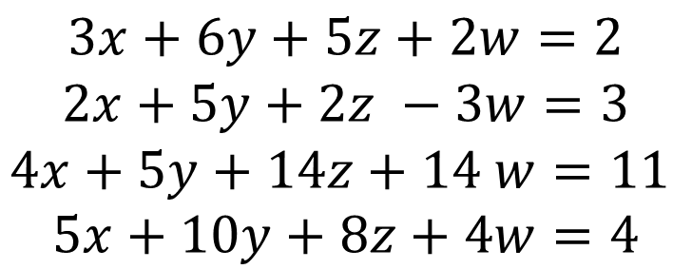
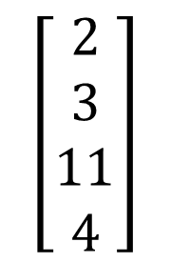
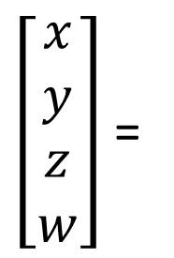
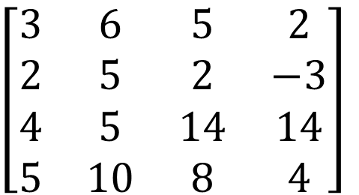
$$Q:Solve the Equations by Gauss Elimination Method$$
$$3x+6y+5z+2w=2$$
$$2x+5y+2z −3w=3$$
$$4x+5y+14z+14 w=11$$
$$5x+10y+8z+4w=4$$
$$Convert equations into Matrix Form$$
$\left[\begin{matrix}3 & 6 & 5 & 2 \\ 2 & 5 & 2 & −3 \\ 4 & 5 & 14 & 14 \\ 5 & 10 & 8 & 4\end{matrix}\right]$
$\left[\begin{matrix}x \\ y \\ z \\ w\end{matrix}\right]$ =
$$\left[\begin{matrix}2 \\ 3 \\ 11 \\ 4\end{matrix}\right]$$
$Subtract R1 from R2 (R1 −R2)→$ R1

Slide 4
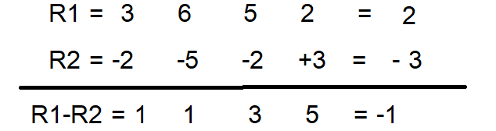
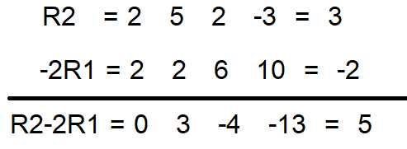
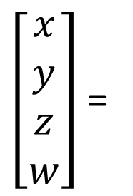
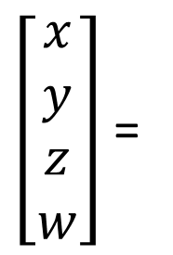
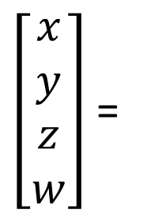
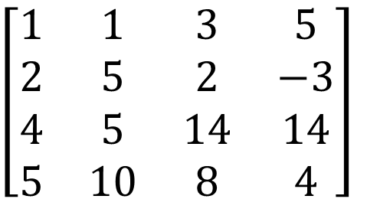
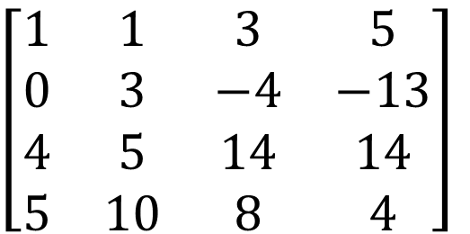
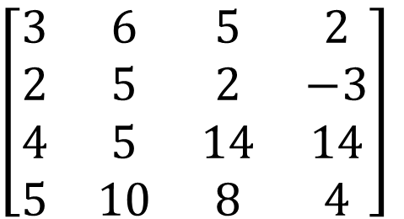
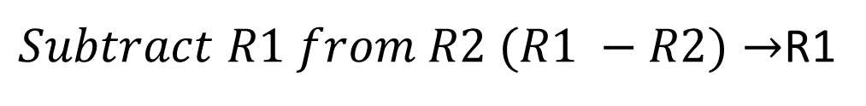
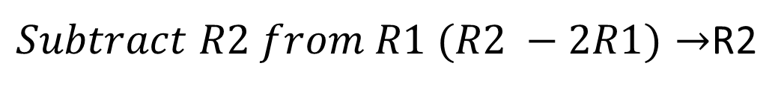
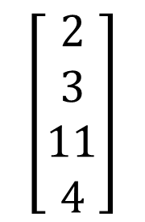
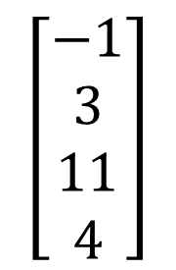
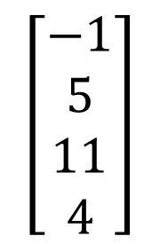
$\left[\begin{matrix}3 & 6 & 5 & 2 \\ 2 & 5 & 2 & −3 \\ 4 & 5 & 14 & 14 \\ 5 & 10 & 8 & 4\end{matrix}\right]$
$\left[\begin{matrix}x \\ y \\ z \\ w\end{matrix}\right]$ =
$$\left[\begin{matrix}2 \\ 3 \\ 11 \\ 4\end{matrix}\right]$$
$Subtract R1 from R2 (R1 −R2)→$R1
$\left[\begin{matrix}1 & 1 & 3 & 5 \\ 2 & 5 & 2 & −3 \\ 4 & 5 & 14 & 14 \\ 5 & 10 & 8 & 4\end{matrix}\right]$
$\left[\begin{matrix}x \\ y \\ z \\ w\end{matrix}\right]$ =
$$\left[\begin{matrix}−1 \\ 3 \\ 11 \\ 4\end{matrix}\right]$$
$Subtract R2 from R1 (R2 −2R1)→$R2
$\left[\begin{matrix}1 & 1 & 3 & 5 \\ 0 & 3 & −4 & −13 \\ 4 & 5 & 14 & 14 \\ 5 & 10 & 8 & 4\end{matrix}\right]$
$\left[\begin{matrix}x \\ y \\ z \\ w\end{matrix}\right]$ =
$$\left[\begin{matrix}−1 \\ 5 \\ 11 \\ 4\end{matrix}\right]$$

Slide 5
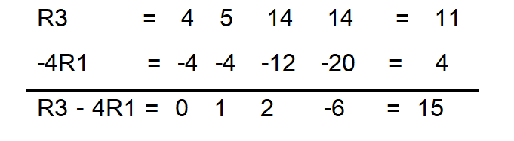
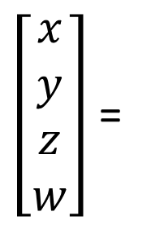
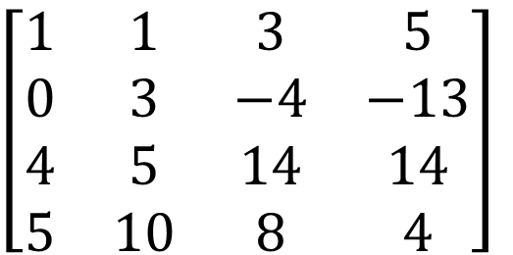
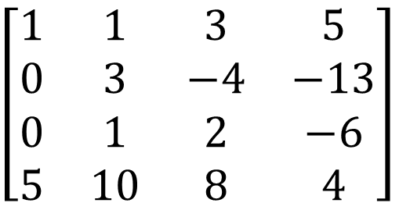
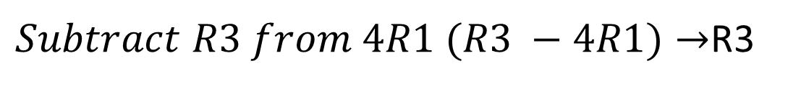
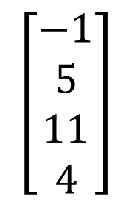
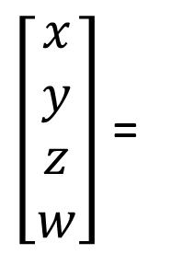
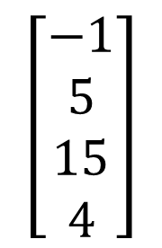
$\left[\begin{matrix}1 & 1 & 3 & 5 \\ 0 & 3 & −4 & −13 \\ 4 & 5 & 14 & 14 \\ 5 & 10 & 8 & 4\end{matrix}\right]$
$\left[\begin{matrix}x \\ y \\ z \\ w\end{matrix}\right]$ =
$$\left[\begin{matrix}−1 \\ 5 \\ 11 \\ 4\end{matrix}\right]$$
$Subtract R3 from 4R1 (R3 −4R1)→$R3
$\left[\begin{matrix}1 & 1 & 3 & 5 \\ 0 & 3 & −4 & −13 \\ 0 & 1 & 2 & −6 \\ 5 & 10 & 8 & 4\end{matrix}\right]$
$\left[\begin{matrix}x \\ y \\ z \\ w\end{matrix}\right]$ =
$$\left[\begin{matrix}−1 \\ 5 \\ 15 \\ 4\end{matrix}\right]$$

Slide 6
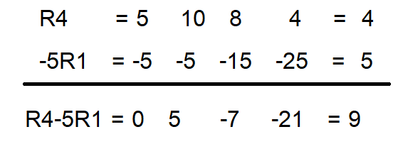
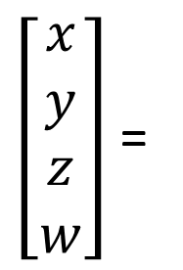
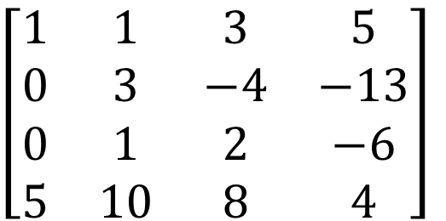
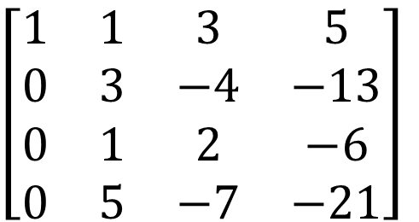
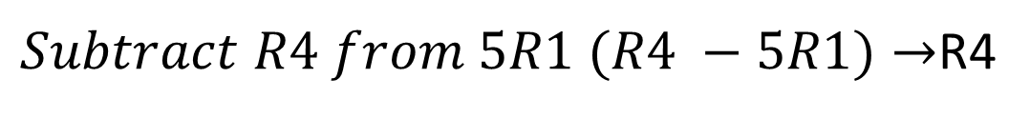
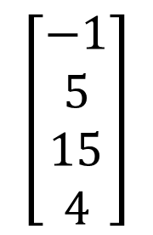
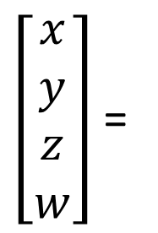
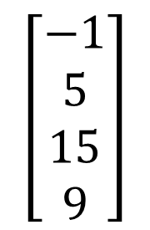
$\left[\begin{matrix}1 & 1 & 3 & 5 \\ 0 & 3 & −4 & −13 \\ 0 & 1 & 2 & −6 \\ 5 & 10 & 8 & 4\end{matrix}\right]$
$\left[\begin{matrix}x \\ y \\ z \\ w\end{matrix}\right]$ =
$$\left[\begin{matrix}−1 \\ 5 \\ 15 \\ 4\end{matrix}\right]$$
$Subtract R4 from 5R1 (R4 −5R1)→$R4
$\left[\begin{matrix}1 & 1 & 3 & 5 \\ 0 & 3 & −4 & −13 \\ 0 & 1 & 2 & −6 \\ 0 & 5 & −7 & −21\end{matrix}\right]$
$\left[\begin{matrix}x \\ y \\ z \\ w\end{matrix}\right]$ =
$$\left[\begin{matrix}−1 \\ 5 \\ 15 \\ 9\end{matrix}\right]$$

Slide 7
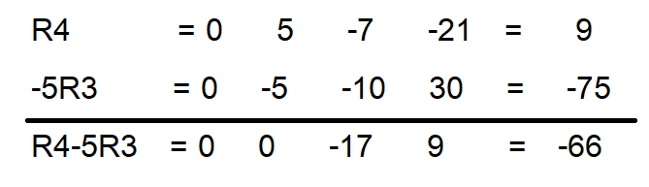
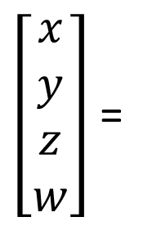
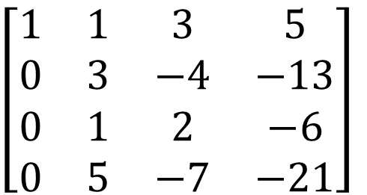
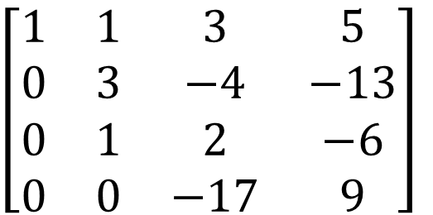
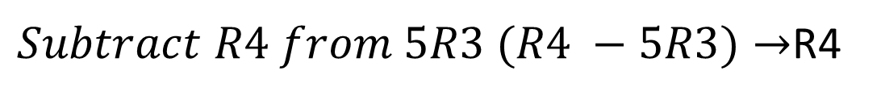
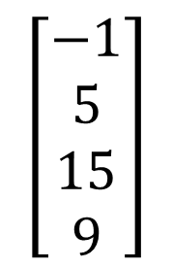
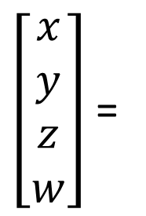
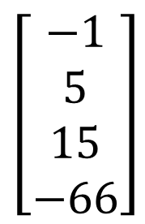
$\left[\begin{matrix}1 & 1 & 3 & 5 \\ 0 & 3 & −4 & −13 \\ 0 & 1 & 2 & −6 \\ 0 & 5 & −7 & −21\end{matrix}\right]$
$\left[\begin{matrix}x \\ y \\ z \\ w\end{matrix}\right]$ =
$$\left[\begin{matrix}−1 \\ 5 \\ 15 \\ 9\end{matrix}\right]$$
$Subtract R4 from 5R3 (R4 −5R3)→$R4
$\left[\begin{matrix}1 & 1 & 3 & 5 \\ 0 & 3 & −4 & −13 \\ 0 & 1 & 2 & −6 \\ 0 & 0 & −17 & 9\end{matrix}\right]$
$\left[\begin{matrix}x \\ y \\ z \\ w\end{matrix}\right]$ =
$$\left[\begin{matrix}−1 \\ 5 \\ 15 \\ −66\end{matrix}\right]$$

Slide 8
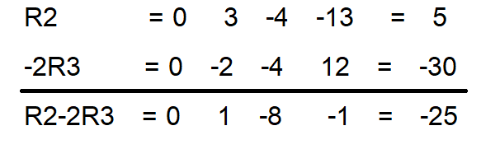
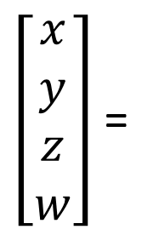
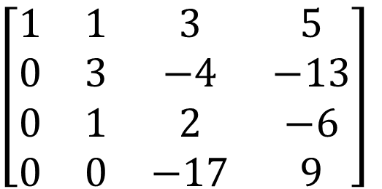
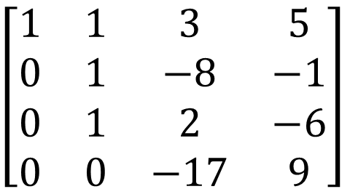
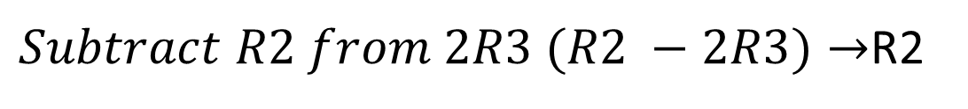
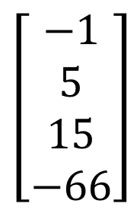
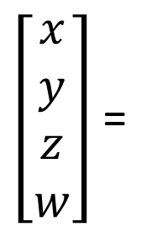
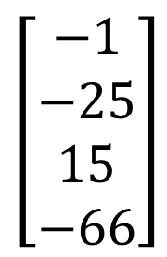
$\left[\begin{matrix}1 & 1 & 3 & 5 \\ 0 & 3 & −4 & −13 \\ 0 & 1 & 2 & −6 \\ 0 & 0 & −17 & 9\end{matrix}\right]$
$\left[\begin{matrix}x \\ y \\ z \\ w\end{matrix}\right]$ =
$$\left[\begin{matrix}−1 \\ 5 \\ 15 \\ −66\end{matrix}\right]$$
$Subtract R2 from 2R3 (R2 −2R3)→$R2
$\left[\begin{matrix}1 & 1 & 3 & 5 \\ 0 & 1 & −8 & −1 \\ 0 & 1 & 2 & −6 \\ 0 & 0 & −17 & 9\end{matrix}\right]$
$\left[\begin{matrix}x \\ y \\ z \\ w\end{matrix}\right]$ =
$$\left[\begin{matrix}−1 \\ −25 \\ 15 \\ −66\end{matrix}\right]$$

Slide 9








$\left[\begin{matrix}1 & 1 & 3 & 5 \\ 0 & 1 & −8 & −1 \\ 0 & 1 & 2 & −6 \\ 0 & 0 & −17 & 9\end{matrix}\right]$
$\left[\begin{matrix}x \\ y \\ z \\ w\end{matrix}\right]$ =
$$\left[\begin{matrix}−1 \\ −25 \\ 15 \\ −66\end{matrix}\right]$$
$Subtract R3 from R2 (R3 −R2)→$R3
$\left[\begin{matrix}1 & 1 & 3 & 5 \\ 0 & 1 & −8 & −1 \\ 0 & 0 & 10 & −5 \\ 0 & 0 & −17 & 9\end{matrix}\right]$
$\left[\begin{matrix}x \\ y \\ z \\ w\end{matrix}\right]$ =
$$\left[\begin{matrix}−1 \\ −25 \\ 40 \\ −66\end{matrix}\right]$$

Slide 10








$\left[\begin{matrix}1 & 1 & 3 & 5 \\ 0 & 1 & −8 & −1 \\ 0 & 0 & 10 & −5 \\ 0 & 0 & −17 & 9\end{matrix}\right]$
$\left[\begin{matrix}x \\ y \\ z \\ w\end{matrix}\right]$ =
$$\left[\begin{matrix}−1 \\ −25 \\ 40 \\ −66\end{matrix}\right]$$
$Add R4 and\frac{17}{10} R3 (R4+\frac{17}{10}R3)→$R4
$\left[\begin{matrix}1 & 1 & 3 & 5 \\ 0 & 1 & −8 & −1 \\ 0 & 0 & 10 & −5 \\ 0 & 0 & 0 & \frac{1}{2}\end{matrix}\right]$
$\left[\begin{matrix}x \\ y \\ z \\ w\end{matrix}\right]$ =
$$\left[\begin{matrix}−1 \\ −25 \\ 40 \\ 2\end{matrix}\right]$$

Slide 11





$\left[\begin{matrix}1 & 1 & 3 & 5 \\ 0 & 1 & −8 & −1 \\ 0 & 0 & 10 & −5 \\ 0 & 0 & 0 & \frac{1}{2}\end{matrix}\right]$
$\left[\begin{matrix}x \\ y \\ z \\ w\end{matrix}\right]$ =
$$\left[\begin{matrix}−1 \\ −25 \\ 40 \\ 2\end{matrix}\right]$$
Backward substitution
$$\frac{1}{2}w=2$$
w = 4
$$10z −5w=40$$
$$10z −5∗4=40$$
$$10z −20=40$$
$$10z=60$$
z = 6
$$y −8z −w=−25$$
$$y −8∗6 −4=−25$$
$$y −48 −4=−25$$
$$y −52=−25$$
y = 27
$$x+y+3z+5w=−1$$
$$x+27+3∗6+5∗4=−1$$
$$x+65=−1$$
$$x=−66$$

Slide 12

$$MATLAB SOLUTION OF \\ GAUSS ELIMINATION METHOD$$
syms x y z w
eqn1 = 3*x+6*y+5*z+2*w==2;
eqn2 = 2*x+5*y+2*z-3*w==3;
eqn3 = 4*x+5*y+14*z+14*w==11;
eqn4 = 5*x+10*y+8*z+4*w==4;
sol = solve([eqn1, eqn2, eqn3, eqn4], [x, y, z,w]);
xSol = sol.x
ySol = sol.y
zSol = sol.z
wSol = sol.w

Slide 13







$$Q:Solve the Equations by Gauss Jordan Method$$
$$x+y−z=7$$
$$x−y+2z=3$$
$$2x+y+z=9$$
$$Convert equations into Matrix Form$$
$\left[\begin{matrix}1 & 1 & −1 \\ 1 & −1 & 2 \\ 2 & 1 & 1\end{matrix}\right]$
$$\left[\begin{matrix}7 \\ 3 \\ 9\end{matrix}\right]$$
$(−R2+R1)$ R2
$\left[\begin{matrix}1 & 1 & −1 \\ 0 & 2 & −3 \\ 2 & 1 & 1\end{matrix}\right]$
$$\left[\begin{matrix}7 \\ 4 \\ 9\end{matrix}\right]$$

Slide 14






$\left[\begin{matrix}1 & 1 & −1 \\ 0 & 2 & −3 \\ 2 & 1 & 1\end{matrix}\right]$
$$\left[\begin{matrix}7 \\ 4 \\ 9\end{matrix}\right]$$
$Subtract R3 from 2R1 (R3 −2R1)→$R3
$\left[\begin{matrix}1 & 1 & −1 \\ 0 & 2 & −3 \\ 0 & −1 & 3\end{matrix}\right]$
$$\left[\begin{matrix}7 \\ 4 \\ −5\end{matrix}\right]$$

Slide 15






$\left[\begin{matrix}1 & 1 & −1 \\ 0 & 2 & −3 \\ 0 & −1 & 3\end{matrix}\right]$
$$\left[\begin{matrix}7 \\ 4 \\ −5\end{matrix}\right]$$
$Add 2R3 and R2 (2R3+R2)→$R3
$\left[\begin{matrix}1 & 1 & −1 \\ 0 & 2 & −3 \\ 0 & 0 & 3\end{matrix}\right]$
$$\left[\begin{matrix}7 \\ 4 \\ −6\end{matrix}\right]$$

Slide 16






$\left[\begin{matrix}1 & 1 & −1 \\ 0 & 2 & −3 \\ 0 & 0 & 3\end{matrix}\right]$
$$\left[\begin{matrix}7 \\ 4 \\ −6\end{matrix}\right]$$
Subtract 3R1$from R2 (3R1−R2)→$R1
$\left[\begin{matrix}3 & 1 & 0 \\ 0 & 2 & −3 \\ 0 & 0 & 3\end{matrix}\right]$
$$\left[\begin{matrix}17 \\ 4 \\ −6\end{matrix}\right]$$

Slide 17





$\left[\begin{matrix}3 & 1 & 0 \\ 0 & 2 & −3 \\ 0 & 0 & 3\end{matrix}\right]$
$$\left[\begin{matrix}17 \\ 4 \\ −6\end{matrix}\right]$$
Add R2$and R3 (R2+R3)→$R2
$\left[\begin{matrix}3 & 1 & 0 \\ 0 & 2 & 0 \\ 0 & 0 & 3\end{matrix}\right]$
$$\left[\begin{matrix}17 \\ −2 \\ −6\end{matrix}\right]$$

Slide 18






$\left[\begin{matrix}3 & 1 & 0 \\ 0 & 2 & 0 \\ 0 & 0 & 3\end{matrix}\right]$
$$\left[\begin{matrix}17 \\ −2 \\ −6\end{matrix}\right]$$
Subtract 2R1$from R2 (2R1 −R2)→$R1
$\left[\begin{matrix}6 & 0 & 0 \\ 0 & 2 & 0 \\ 0 & 0 & 3\end{matrix}\right]$
$$\left[\begin{matrix}36 \\ −2 \\ −6\end{matrix}\right]$$

Slide 19







$\left[\begin{matrix}6 & 0 & 0 \\ 0 & 2 & 0 \\ 0 & 0 & 3\end{matrix}\right]$
$$\left[\begin{matrix}36 \\ −2 \\ −6\end{matrix}\right]$$
$$\frac{1}{6}R1,\frac{1}{2}R2 and\frac{1}{3}R3$$
Check
$x+y−z=7$ ↔6 -1 +2 =7 ↔7=7
$x−y+2z=3$ ↔6 +1 -4 = 3 ↔3=3
$2x+y+z=9\text{↔}$ 2*6 -1 -2 = 9 ↔9 = 9
$\left[\begin{matrix}1 & 0 & 0 \\ 0 & 1 & 0 \\ 0 & 0 & 1\end{matrix}\right]$
$$\left[\begin{matrix}6 \\ −1 \\ −2\end{matrix}\right]$$
$$x=6, y=−1 and z=−2$$

Slide 20







Slide 23



Slide 24





Slide 25






Slide 26




Slide 27





Slide 28




$$Q:Solve the Equations by Jacobi^{′}s Iteration Method$$
$$15x+2y+z=18$$
$$2x+20y−3z=19$$
$$3x−6y+25z=22$$
We observed in equations all diagonal values are greater than other variables in same row, than Jacobi’s applicable to solve system of linear equations
$$x=\frac{1}{15}\left(18 −2y −z\right)$$
$$y=\frac{1}{20}\left(19−2x+3z\right)$$
$$z=\frac{1}{25}\left(22 −3x+6y\right)$$

Slide 29






$$x=\frac{1}{15}\left(18 −2y −z\right)$$
$$y=\frac{1}{20}\left(19−2x+3z\right)$$
$$z=\frac{1}{25}\left(22 −3x+6y\right)$$
$$First Iteration$$
$$Put x=0, y=0 and z=0 OR x_{0}=0,y_{0}=0 and{ z}_{0}=0$$
$$x_{1}=\frac{1}{15}\left(18 −2∗0−0\right)=\frac{18}{15}=1.2$$
$y_{1}=\frac{1}{20}\left(19−2∗0+3∗0\right)=\frac{19}{20}=0.95$
$$z_{1}=\frac{1}{25}\left(22 −3∗0+6∗0\right)=\frac{22}{25}=0.88$$

Slide 30







$$Second Iteration$$
$$x=\frac{1}{15}\left(18 −2y −z\right)$$
$$Put x_{1}=1.2,y_{1}=0.95 and z_{1}=0.88$$
$$y=\frac{1}{20}\left(19−2x+3z\right)$$
$$x_{2}=\frac{1}{15}\left(18 −2∗0.95−0.88\right)=1.0147$$
$$z=\frac{1}{25}\left(22 −3x+6y\right)$$
$$y_{2}=\frac{1}{20}\left(19−2∗1.2+3∗0.88\right)=0.962$$
$$z_{2}=\frac{1}{25}\left(22 −3∗1.2+6∗0.95\right)=0.964$$

Slide 31




$$Third Iteration$$
$$x=\frac{1}{15}\left(18 −2y −z\right)$$
$$Put x_{2}=1.0147,y_{2}=0.962 and z_{2}=0.964$$
$$y=\frac{1}{20}\left(19−2x+3z\right)$$
$$x_{3}=\frac{1}{15}\left(18 −2∗0.962−0.964\right)=1.0075$$
$$z=\frac{1}{25}\left(22 −3x+6y\right)$$
$$y_{3}=\frac{1}{20}\left(19−2∗1.0147+3∗0.964\right)=0.9931$$
$$z_{3}=\frac{1}{25}\left(22 −3∗1.0147+6∗0.962\right)=0.9891$$

Slide 32




$$Fourth Iteration$$
$$x=\frac{1}{15}\left(18 −2y −z\right)$$
$$Put x_{3}=1.0075,y_{3}=0.9931 and z_{3}=0.9891$$
$$y=\frac{1}{20}\left(19−2x+3z\right)$$
$$x_{4}=\frac{1}{15}\left(18 −2∗0.9931−0.9891\right)=1.0016$$
$$z=\frac{1}{25}\left(22 −3x+6y\right)$$
$$y_{4}=\frac{1}{20}\left(19−2∗1.0075+3∗0.9891\right)=0.9976$$
$$z_{4}=\frac{1}{25}\left(22 −3∗1.0075+6∗0.9931\right)=0.9974$$

Slide 33




$$Fifth Iteration$$
$$x=\frac{1}{15}\left(18 −2y −z\right)$$
$$Put x_{4}=1.0016,y_{4}=0.9976 and z_{4}=0.9974$$
$$y=\frac{1}{20}\left(19−2x+3z\right)$$
$$x_{5}=\frac{1}{15}\left(18 −2∗0.9976−0.9974\right)=1.0005$$
$$z=\frac{1}{25}\left(22 −3x+6y\right)$$
$$y_{5}=\frac{1}{20}\left(19−2∗1.0016+3∗0.9974\right)=0.9994$$
$$z_{5}=\frac{1}{25}\left(22 −3∗1.0016+6∗0.9976\right)=0.9980$$

Slide 34



$$Sixth Iteration$$
$$x=\frac{1}{15}\left(18 −2y −z\right)$$
$$Put x_{5}=1.0005,y_{5}=0.9994 and z_{5}=0.9980$$
$$y=\frac{1}{20}\left(19−2x+3z\right)$$
$$x_{6}=\frac{1}{15}\left(18 −2∗0.9994−0.9980\right)=1.0002≅1$$
$$z=\frac{1}{25}\left(22 −3x+6y\right)$$
$$y_{6}=\frac{1}{20}\left(19−2∗1.0005+3∗0.9980\right)=0.9996≅1$$
$$z_{6}=\frac{1}{25}\left(22 −3∗1.0005+6∗0.9994\right)=0.9998≅1$$
$$Therefore, may be next iterations its values are equal to 1$$
$$x=y=z =1$$

Slide 35



$$CHECKING$$
$$Put x=y=z =1$$
$15x+2y+z=1815∗1+2∗1+1=18$18 = 18
$2x+20y−3z=19$ $$ $2∗1+20∗1−3∗1=19$ $$19=19
$3x−6y+25z=22$ $3∗1−6∗1+25∗1=22$ $$22 = 22

Slide 36









Gauss Seidal Method
$$Q:Consider the following system of linear equations, using Gauss Seidal$$
$Method$ to solve next iteration
$10x_{1}−$ $x_{2}+2x_{3}=6$
$$−x_{1}+11x_{2}−x_{3}+3x_{4}=25$$
${2x}_{1}−$ $x_{2}+10x_{3}−x_{4}=11$
$$3x_{2}−x_{3}+8x_{4}=15$$
$$Initial guess{ x}_{1}=0,x_{2}=0,x_{2}=0$$
$$SOLUTION$$
$$x_{3}=\frac{11−2x_{1}+x_{2}+x_{4}}{3} …..(3)$$
$$x_{1}=\frac{6+x_{2} −2x_{3}}{10} …..(1)$$
$$x_{4}=\frac{15−3x_{2}+x_{3}}{8} …..(4)$$
$$x_{2}=\frac{25+x_{1}+x_{3}−3x_{4}}{11} …..(2)$$

Slide 37




$$x_{1}=\frac{12+x_{2} −2x_{3}}{4} …..(1)$$
$$x_{2}=\frac{−20−3x_{1}+2x_{3}}{8} …..(2)$$
$$x_{3}=\frac{10−x_{1} −x_{2}}{3} …..(3)$$
 | 1 | 2 | 3
$$x_{1}$$ | 0 | $$\frac{12+0−0}{4} =3$$ | $$\frac{12−\frac{29}{8}−2∗\frac{85}{24}}{4} =\frac{12−\frac{29}{8}−\frac{85}{12}}{4}$$ $$=\frac{\frac{96−29}{8}−\frac{85}{12}}{4}$$ $$=\frac{\frac{67}{8}−\frac{85}{12}}{4}=\frac{\frac{5752}{96}}{\frac{4}{1}}=\frac{5752}{384}$$ | $$\frac{12+0−0}{4} =3$$
$$x_{2}$$ | 0 | $$\frac{−20−3∗3+2∗0}{8} =\frac{−29}{8}$$
$$x_{3}$$ | 0 | $$\frac{10−3 −(−\frac{29}{8})}{3} =$$ $$\frac{7+\frac{29}{8}}{3}= \frac{\frac{56}{8}+\frac{29}{8}}{3}= \frac{\frac{85}{8}}{\frac{3}{1}}$$ $$=\frac{85}{24}$$

Slide 38



Slide 39
Newton Raphson Method
X_{n+1} = X_{n} – f(x_{n} )/ f’ (x_{n} )
Example: Apply newton Raphson Method, to find the real roots of equation
f(x) = 3x – cos(x) - 1
f’(x) = 3 + sin(x)

Slide 40
Newton Raphson Method
Value*(180/pi) = 57.2957 values in degree
f(x) = 3x – cos(x) - 1
f(0) = 3*0 – cos(0) - 1 = -Ve
f(1) = 3*1 – cos (57.2957) - 1 = +ve
x₀ = 0.6

Slide 41

Newton Raphson Method
X_{n+1} = X_{n} – f(x_{n} )/ f’ (x_{n} )
X_{n+1} = X_{n} –{3x – cos(x) - 1}/ {3 + sin(x) }
-------------(A)
Put n = 0
x₁ = [x₀ *sinx₀ + cosx₀ + 1]/(3 + sinx₀)
x₁ = [0.6 *sin(0.6* 57.2957 ) + cos(0.6* 57.2957) + 1]/(3 + sin(0.6* 57.2957 ))
x₁ = 0.6071

Slide 42
Newton Raphson Method
Put n = 1
x₂ = [x₁ *sinx₁ + cosx₁ + 1]/(3 + sinx₁)
x₂ = [0.6071 *sin(0.6071* 57.2957) + cos(0.6071* 57.2957) + 1]/(3 + sin(0.6071* 57.2957))
x₂ = 0.6071

